Slide 1




INHERITANCE

Slide 2
Why do we go for OOPS Concept?
It helps to reduce the complexity and also improves the maintainability of the system. When combined with the concepts of the Encapsulation and Polymorphism, Abstraction gives more power to the Object oriented programming languages.

Slide 3
Encapsulation
Encapsulation in Java is a mechanism of wrapping the data (variables) and code acting on the data (methods) together as a single unit. ... Declare the variables of a class as private. Provide public setter and getter methods to modify and view the variables values.

Slide 4


Slide 5
Encapsulation With Real Time Example
When you log into your email, compose and send a mail. Again there is a whole lot of background processing involved, verifying the recipient, sending request to the email server, sending your email. Here you are only interested in composing and clicking on the send button. What really happens when you click on the send button, is hidden from you.

Slide 6
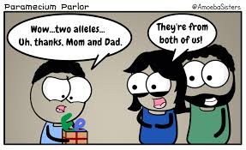
What Do you Understand about this?

Slide 7
WHAT IS INHERITANCE?
Inheritance in Java is a mechanism in which one object acquires all the properties and behaviors of a parent object. It is an important part of OOPs (Object Oriented programming system).

Slide 8
SYNTAX FOR INHERITANCE
class Subclass-name extends Superclass-name
{
//methods and fields
}

Slide 9
TYPES OF INHERITANCE
Single Inheritance
Multiple Inheritance
Multilevel Inheritance
Hierarchical Inheritance
Hybrid Inheritance

Slide 10
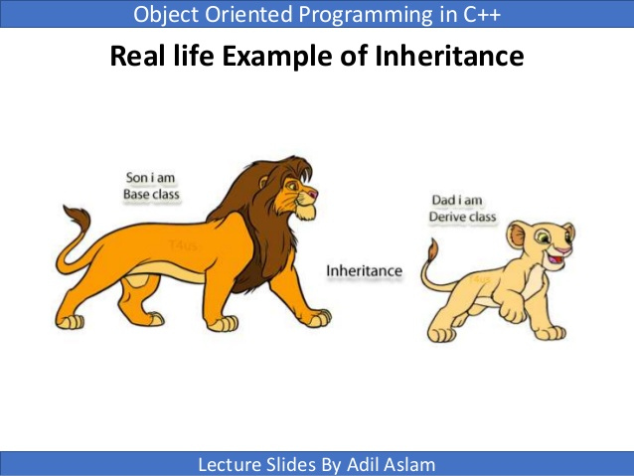
REAL TIME EXAMPLE

Slide 11
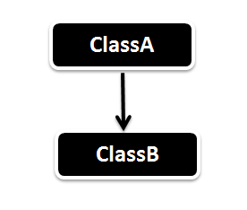
SINGLE INHERITANCE

Slide 12
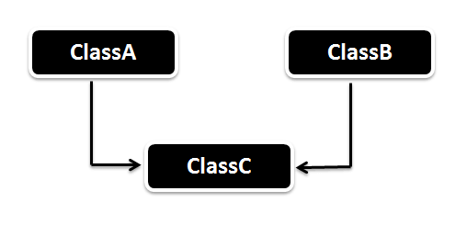
MULTIPLE INHERITANCE

Slide 13
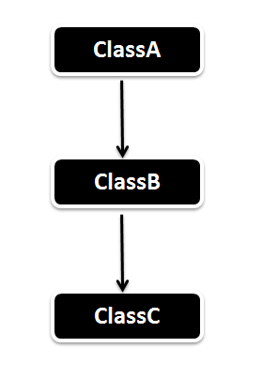
MULTILEVEL INHERITANCE

Slide 14
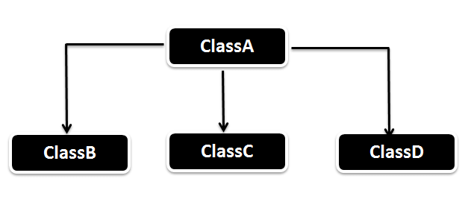
HIERARCHICAL INHERITANCE
Hierarchical Inheritance

Slide 15
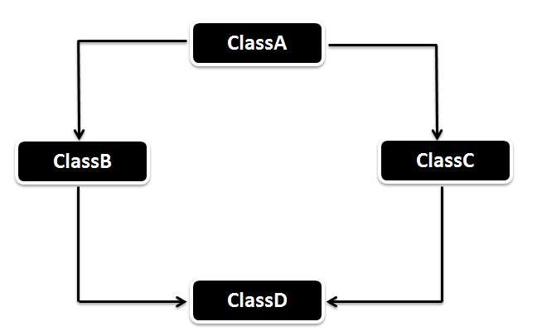
HYBRID INHERITANCE

Slide 16


